Slide 1
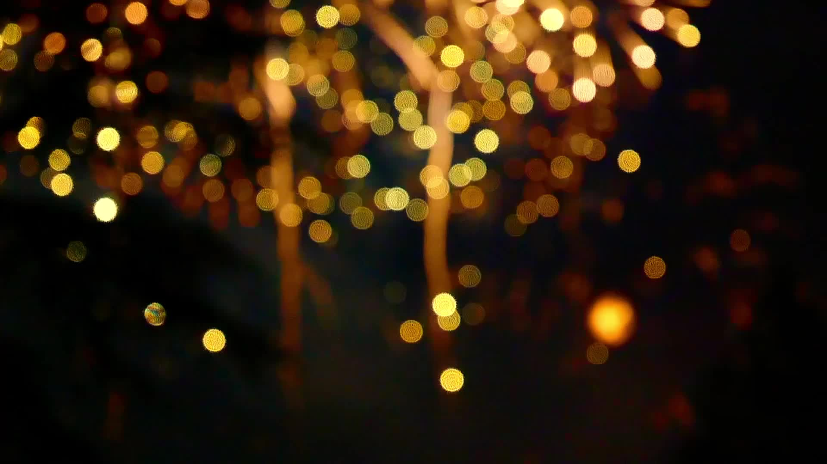
MOCKUP

Slide 2
Registration/Login in
Little Planet
welcome
Email Address
Password
Login
Create a new account
Forget password
version

Slide 3
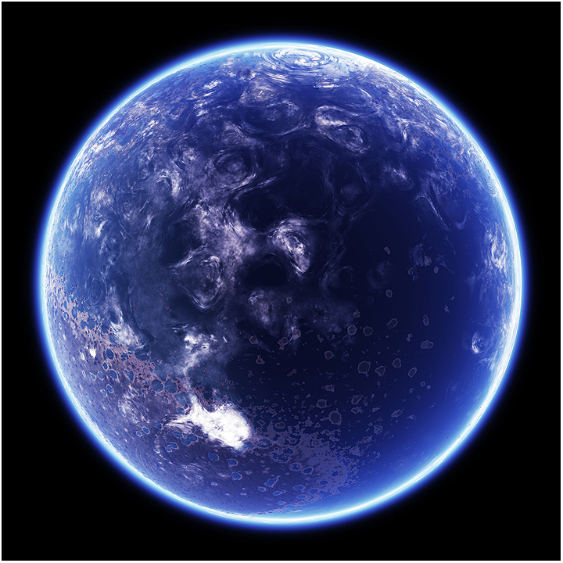
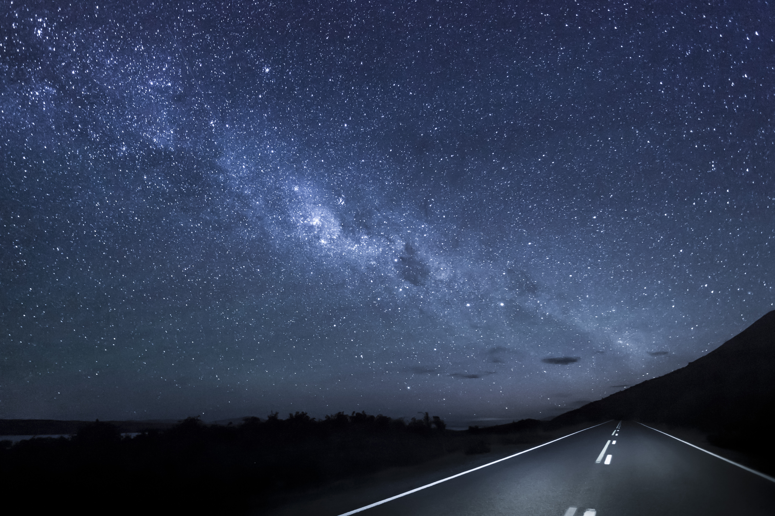
Planet View
Pic Copyrights:
This Photo by Unknown author is licensed under CC BY-NC.
Planet View (Main interface)
Total goals achieved:
Countries in your planet:
Cities in your planet:
The navigation bar:1. Main 2. Set goal 3. track your goal 4. see your achievement
The navigation bar

Slide 4


Goal Setting
Write down your goal!
Name : _________________​
Duration : From DD/MM/YY​
To DD/MM/YY
​Details : _________________
_________________​
Comment : _________________
_________________
_________________
return
confirm
The navigation bar

Slide 5
Share the schedule
Progress Tracker
reward
goal :
Time:
Progress:
(The background is the reward image)
end
suspend
The navigation bar

Slide 6
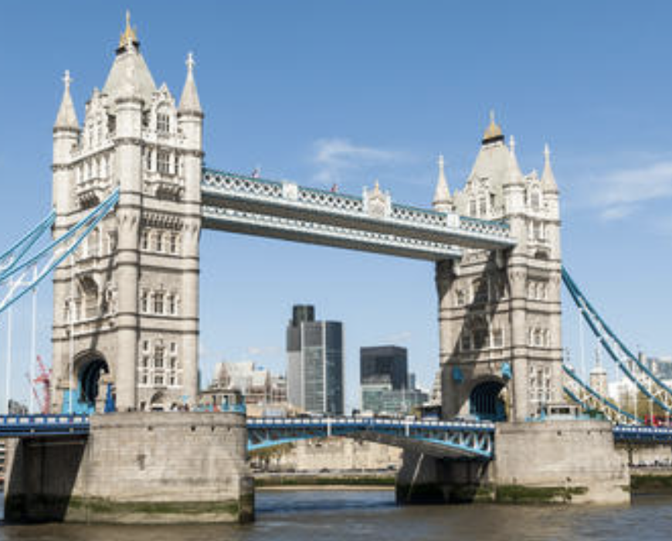
Collection of pictures
Congratulations!
You have completed a goal!
Collection
The navigation bar

